Slide 1

ICT504 IT Strategy & Leadership Week 7 System Strategy Dr. Farshid Keivanian

Slide 2
Lecture Outline
ICT Strategy Formulation.
ICT Technique Framework.
Critical Success Factors.
ICT Investment.
Large Organisations.

Slide 3
ICT Needs and Opportunities
Key Idea: ICT is required when changes happen in business, social settings, or technology. It also helps improve internal processes and resources.
Simplified Explanation (with Analogy): Think of ICT like a GPS system in a car. When traffic, road conditions, or destinations change (like business needs or competitors), ICT helps you reroute and reach goals more efficiently.

Slide 4
ICT Needs and Opportunities
Australian Example: During COVID-19, Woolworths shifted heavily to online shopping. ICT helped them adapt by upgrading delivery systems and mobile apps.

Slide 5
ICT Needs and Opportunities
Discussion Questions:
Which area (business, social, technology) do you think drives ICT changes most rapidly today?
How did Australian companies adapt ICT during the pandemic?
Many will mention remote work systems like Zoom, new e-commerce tools, or changes in digital customer service.

Slide 6
Hands-On Activity
Task: List ICT tools used by Australian universities during COVID (e.g., Microsoft Team, Moodle, LMS, Zoom). For each, identify what need it responded to (e.g., social distancing, remote teaching).

Slide 7
Problem-Solving Example
Scenario: A retail company faces rising online competition. Identify two ICT strategies it could use to stay competitive.
Answer hint: Improve website experience, automate inventory with AI.

Slide 8
Role-Playing Debate
Prompt: "ICT change should be driven more by internal efficiency than external pressure." Assign one team to argue for internal needs (cost, operations), and one for external needs (competitors, trends).
Brief answer: Both are important, but external pressures often force faster action.

Slide 9
ICT Strategy Formulation – 4 Key Types
Strategy Type | What It Means (Simple) | Real-World Analogy | Australian Example
External Long Term | Big changes outside the business that impact us over time. | Like climate change—you must plan ahead | COVID-19 affecting travel & economy long-term (Qantas going digital)
External Short Term | Quick shocks or changes from outside (e.g., new rivals, new tech). | Like sudden weather—you need an umbrella fast | Uber entering Australian market – taxis had to react quickly

Slide 10
ICT Strategy Formulation – 4 Key Types
Strategy Type | What It Means (Simple) | Real-World Analogy | Australian Example
Internal Long Term | Inside changes that take time—new systems or new ways of working. | Renovating your house to live better | Telstra adopting AI over 5 years to change its customer service model
Internal Short Term | Use what you already have, but do it better. | Tuning up your car for better mileage | Using existing ICT tools to improve online learning at University of Sydney

Slide 11
Real-World Analogy Recap
Imagine you're running a cafe:
External Long Term: New laws banning plastic cups (you need new strategy for packaging).
External Short Term: A new cafe opens across the street with better coffee (react fast).
Internal Long Term: You decide to add delivery services (needs investment, training).
Internal Short Term: You rearrange your counter to serve customers faster using existing staff.

Slide 12
ICT Technique Framework – 3 Application Types
Term | Simple Meaning | Analogy (Everyday Life) | Australian Example
1. Existing Applications | Tools the company is using right now. They helped in the past but might not align with current needs. | Old phone apps you used to use every day, but now barely open. | Many banks still use legacy mainframe systems for transactions.
2. Required Applications | Tools the company must get to reach its future goals. | Like needing a navigation app before a road trip. | Aged care providers adopting electronic medical records to meet compliance.
3. Potential Applications | Tools that might be helpful in the future—optional but promising. | Like thinking of buying a smartwatch for future fitness goals. | Exploring AI tools like ChatGPT for customer service at Telstra or NAB.

Slide 13
ICT Technique Framework – 3 Application Types
Real-World Analogy Recap
Example – University Student Analogy
Existing App: Moodle or Blackboard (already used daily).
Required App: Zoom or Teams (needed for live classes).
Potential App: AI assistant for assignment help (could be useful soon).

Slide 14
Strategic ICT Decisions
Concept | Simple Meaning | Analogy | Australian Example
1. Deploy ICT Resources Wisely | Use existing tech and money in the smartest way now. | Like planning a grocery budget—buy what you need, not what looks cool. | A council deciding to invest in better Wi-Fi across public libraries.
2. Evaluate Environments | Check what’s changing both inside (staff, tools) and outside (market, tech). | Like checking weather before a trip—conditions may affect your path. | Aussie retailers adapting to AI chatbots due to customer demand.
3. Spot New Innovations | Keep an eye out for tech that can help or disrupt. | Like watching out for new apps that make your life easier or your job harder. | Schools trialling VR classrooms to improve remote education.

Slide 15
Impacts of ICT on Business
Impact Area | What It Means | Example in Australia
Performance | Do things faster, better, and more creatively. | Commonwealth Bank’s AI systems improving fraud detection.
Growth | Help the business sell more or reach more people. | Afterpay’s growth with easy digital payments.
Expansion | Grow into new areas or communicate globally. | Atlassian expanding teams globally using digital collaboration tools.
New Products | Create better or brand-new offerings. | Telstra launching 5G-enabled services to improve mobile experience.

Slide 16
Analogy Wrap-Up
Think of a business like a farm:
ICT tools help improve how well crops grow (performance),
increase how much you can sell (growth),
allow you to expand to new fields (expansion), and
create new products like jams or juices (innovation).

Slide 17
Large Organisation ICT Strategy (Full View)
Concept | Simple Meaning | Real-World Analogy | Australian Example
Same or similar customers/suppliers | Units serve the same audience or buy from the same vendors. | Like different Woolworths stores serving the same kind of shoppers. | Woolworths and BIG W sharing suppliers and logistics.
Trading internally (value chain links) | Units buy/sell from one another, helping the company as a whole. | Like departments in a uni sharing course materials. | BHP’s mining units using shared IT platforms for logistics.
10

Slide 18
Large Organisation ICT Strategy (Full View)
Concept | Simple Meaning | Real-World Analogy | Australian Example
Shared value chains | They use the same process models or tools. | Like restaurants using the same kitchen system. | Kmart and Target using shared inventory systems (both under Wesfarmers).
Same size and structure | Business units are similarly large and operate on the same scale. | Like campuses in a national university network. | ANZ Bank branches with similar layouts and service structures.
10

Slide 19
Large Organisation ICT Strategy (Full View)
Concept | Simple Meaning | Real-World Analogy | Australian Example
Similar strategies and CSFs | All units follow the same business goals. | Like a sports team with the same training plan for all players. | Commonwealth Bank aligning all branches to digital transformation goals.
Parent company wants consistency | Headquarters needs a standard system across all units. | Like having a shared calendar app across a team. | Government departments using GovCMS for all websites.
10

Slide 20
Large Organisation ICT Strategy (Full View)
Concept | Simple Meaning | Real-World Analogy | Australian Example
Shared support activities | Support systems (e.g., HR, finance) are the same or outsourced. | Like everyone in a company using the same payroll system. | Department of Education using centralized IT helpdesk across all schools.
10

Slide 21
Analogy Recap
Think of a franchise business like McDonald's Australia:
All branches look and feel the same.
They use the same supplier (e.g., Coca-Cola, McCain).
They follow the same system to manage inventory and customers.
This standardisation helps with cost savings, efficiency, and brand control.
10

Slide 22
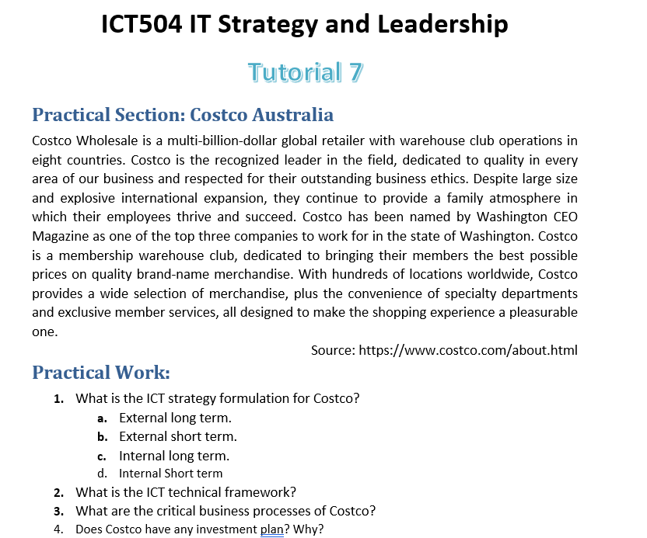
Presentation + Tutorial Week 7 (Topic 1)
10

Slide 23
Topic 1: How Large Organisations Align ICT Across Multiple Business Units
10
Task: Choose a large organisation with multiple divisions (e.g., Wesfarmers, Woolworths Group, Commonwealth Bank).

Slide 24
Topic 1: How Large Organisations Align ICT Across Multiple Business Units
10
Explore how the organisation:
Shares ICT infrastructure across units
Maintains consistent data, systems, and communication
Deals with internal value chains, shared customers, and suppliers
Aligns ICT with business strategies and Critical Success Factors (CSFs)

Slide 25
Topic 1: How Large Organisations Align ICT Across Multiple Business Units
10
Presentation Focus:
Challenges of coordination in large-scale ICT deployment
Benefits of shared services and value chain integration
Real examples of systems (e.g., ERP, cloud, CRM) used across units

Slide 26
Topic 1: How Large Organisations Align ICT Across Multiple Business Units
10
Suggested Structure:
Brief overview of the organisation and its business units
Diagram of shared ICT systems or architecture
Real benefits and risks
How this aligns with lecture content (value chain, CSFs, strategy)

Slide 27
Topic 2: ICT Strategy in Action – Case Study of an Australian Organisation
10
Task: Choose a well-known Australian organisation (e.g., Woolworths, Telstra, ANZ, Canva). Explore how they have:
Responded to external or internal ICT challenges
Made ICT investment decisions (e.g., automation, AI, cloud)
Integrated ICT across different units or branches

Slide 28
Topic 2: ICT Strategy in Action – Case Study of an Australian Organisation
10
Presentation Focus:
Strategy type: external/internal, short/long term
Use of existing, required, and potential applications
Impact on business performance and innovation
Tip: Students should use news sources, annual reports, and ICT blogs to support their analysis

Slide 29
Topic 3: Automate or Eliminate? Evaluating Critical Business Processes
10
Task: Pick a specific industry (e.g., retail, education, logistics, healthcare) and:
Identify at least 3 processes
Classify them as high-cost/low-value or high-value
Propose which processes should be automated using ICT
Justify with Critical Success Factors (CSFs)

Slide 30
Topic 3: Automate or Eliminate? Evaluating Critical Business Processes
10
Presentation Focus:
Business process mapping
ICT benefits vs investment cost
Role of automation in strategic alignment
Tip: Encourage examples from Australia like MyGov, ATO, or university systems.

Slide 31
Topic 4: Designing ICT Investment Options for the Future
Task: Imagine you’re advising a mid-sized Australian business expanding to a new market.
Propose ICT investment options that fit their growth goals
Evaluate options by performance, customer experience, and competitive edge
Highlight at least one “potential application” using an emerging technology (e.g., AR, AI, blockchain)
10

Slide 32
Topic 4: Designing ICT Investment Options for the Future
10
Presentation Focus:
Short vs long-term gains
Strategic fit with business model
Realistic budget considerations
Tip: Encourage teams to include a simple cost–benefit table or impact map.

Slide 33

Reading Materials

Slide 34
Articles
Bharadwaj, O.A. El Sawy, P. Pavlou and N. Venkatraman, ‘Digital business strategy: toward a next generation of insights’, MIS Quarterly, 37, 2, 2013, 471–482.
https://www.outsourceaccelerator.com/articles/strategic-information/
https://www.uagc.edu/blog/how-are-information-systems-transforming-business
https://www.uagc.edu/blog/what-is-business-information-systems

